Slide 1


Curriculum Area: Animals Including Humans
Topic: Humans
Year Group | Vocabulary
EYFS | senses, eyes, sight, taste, touch, senses, hearing, sight, sound, yellow, smell, touch, taste, orange, slice, taste, senses, colour, sight, taste buds, arm, leg, chest, jump, move, hand, finger, feet, walk, run, eyes, nose, face, blink, colour, ears, mouth, hair, eyebrows, teeth, baby, food, grow, hair, teeth, freckles, gene, sibling, different, unique, trust, uncomfortable, police officer, stranger danger, stranger, 999, burn, cut, first aid, plaster, diet, exercise, tooth, healthy, fuel
Year 1 | head, body, skeleton, limb, joint, brain, eyelash, eye, sight, pupil, sound, ear, sign language, vibration, deafness, tongue, mouth, taste, flavour, sweet, touch, fingertips, skin, organ, brain, smell, odour, nose, nostril, nose hair
Year 2 | survival, shelter, nutrition, oxygen, essential, vital, non-essential, survive, grow, healthy, protein, carbohydrate, dairy, vitamins, calcium, fat, balanced diet, nutrients, fresh food, pre-cooked, processed food, exercise, strength, flexibility, balance, coordination, hygiene, prevent, germs, bacteria, virus, life cycle, grow, survive, independent, adult, foetus, womb, helpless, toddler, develop
Year 3 | nutrition, carbohydrate, protein, vitamin, mineral, nutrition label, portion, energy, balanced, diet, vertebrate, invertebrate, endoskeleton, exoskeleton, hydrostatic skeleton, humerus, ulna, radius, tibia, fibular, endoskeleton, vertebrate, skull, rib cage, spine, muscle, contract, hamstrings, biceps, diaphragm
Year 4 | digestive system, oesophagus, stomach, small intestine, large intestine, saliva, peristalsis, absorb, liver, gall bladder, incisors, canines, molars, jaw, gum, enamel, plaque, tooth decay, cavity, fluoride
Year 5 | foetus, dependent, adolescent, puberty, reproduce, gestation, pregnant, duration, extreme, breeding, womb, umbilical chord, embryo, trimester, midwife, growth spurt, childhood, motor skills, milk teeth, constant, adolescence, puberty, hormones, mood swing, develop, lifestyle, keratin, elasticity, cataracts, neurodegenerative
Year 6 | circulatory system, atrium, ventricle, vessel, valves, vessel, artery, vein, capillary, microscope, blood, plasma, platelet, white blood cell, red blood cell, absorb, diffusion, osmosis, concentration, nutrients, diet, exercise, heart rate, BPM, pulse, drug, painkiller, stimulant, depressant, hallucinogens
Developing Experts Copyright 2024 All Rights Reserved

Slide 2

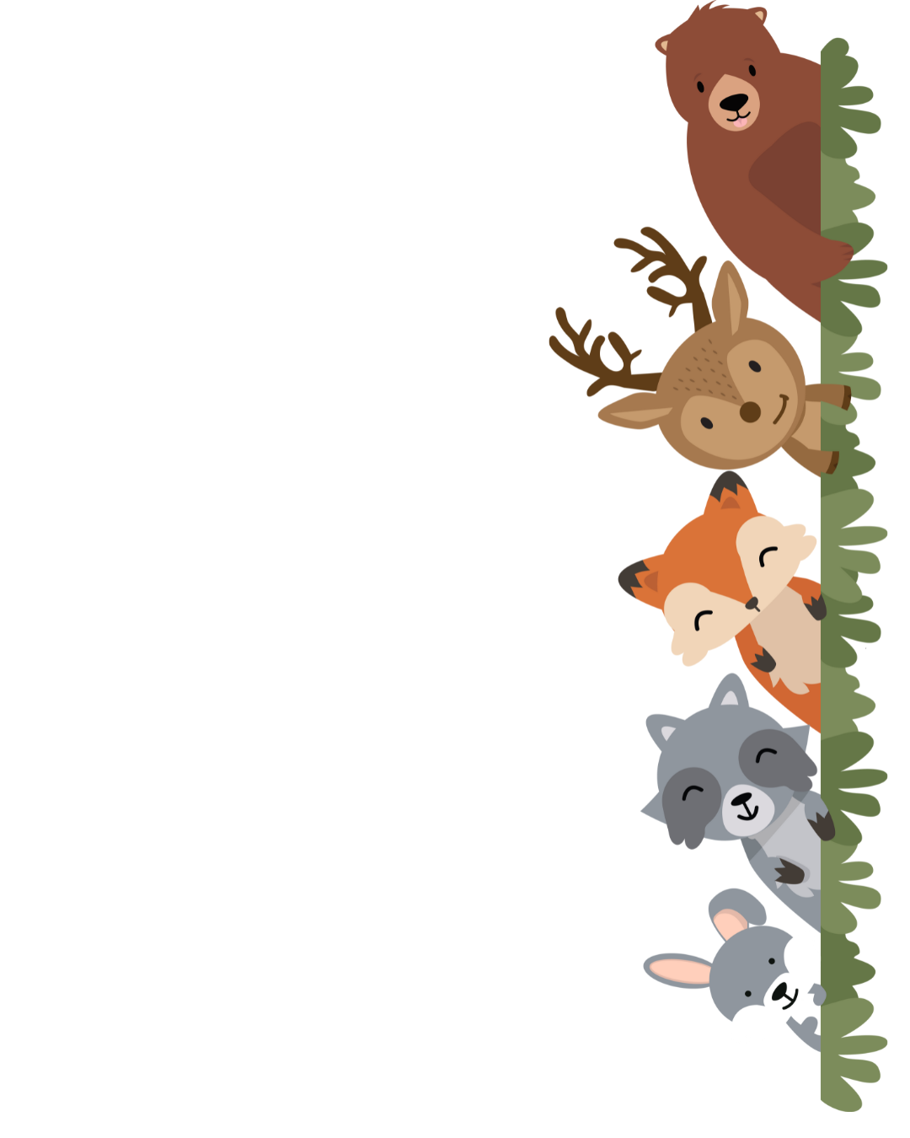
Curriculum Area: Animals Including Humans
Topic: Animals
Year Group | Vocabulary
EYFS | fly, beetle, insect, ant, invertebrate, ladybird, spider, snail, honey, worm, sap, habitat, greenfly, food, toast, chicken, egg, lay, fox, chick, cow, milk, cream, cheese, butter, living, tree, adult, non living, young, pet, ocean, habitat, desert, farm, bird, nest, build, mud, grass, pig, horse, cow, goat, chicken, dinosaur, lizard, meteorite, museum, reptile
Year 1 | fish, amphibian, reptile, mammal, bird, feather, warm-blooded, characteristic, backbone, hatchling, amphibian, reptile, gills, scale, cold-blooded, herbivore, carnivore, omnivore, predator, canines, pet, wild, shelter, veterinary, natural, similarities, differences, compare, unsuitable, climate
Year 2 | offspring, inherit, gene, resemble, differences, reproduction, hatchling, chick, bar chart, predict, caterpillar, transformation, larva, chrysalis, metamorphosis, frog, amphibian, frogspawn, tadpole, froglet
Year 3
Year 4 | ecosystem, producer, consumer, prey, predator, food web, tundra, hide, interdependence, threatened
Year 5
Year 6
Developing Experts Copyright 2024 All Rights Reserved

Slide 3
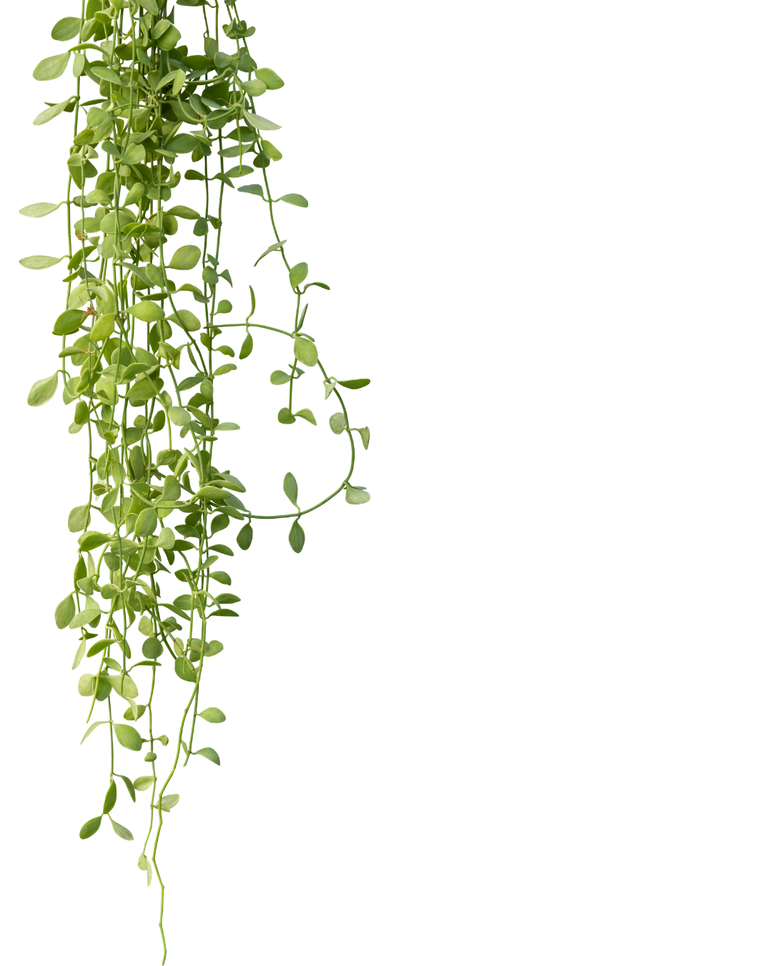

Curriculum Area: Plants
Topic: Plants
Year Group | Vocabulary
EYFS | plant, seed, nutrients, soil, water, plant, soil, seed, stem, pink, sunlight, compost heap, weeds, garden, roots
Year 1 | seed, plant, tree, soil, predict, stem, petal, leaf, root, flower, environment, weed, daisy, dandelion, wild, deciduous, evergreen, seasons, branch, bush, supermarket, fruit, vegetable, farm, tractor, growth, seedling, young plant, adult plant, observe,
Year 2 | seeds, bulbs, growth, plant, compare, predict, investigate, control, experiment, method, photosynthesis, carbon dioxide, oxygen, glucose, energy, pollination, life cycle, germination, reproduction, seedling, manure, crop, insulate, thrive, healthy, forest, desert, adapt, condition, survive
Year 3 | nutrients, fertiliser, nursery, potassium, stunted, chlorophyll, stomata, xylem, photosynthesis, UV light, xylem, phloem, absorb, stomata, transpiration, anther, stigma, style, filament, reproduction, pollination, pollen, nectar, seed dispersal, pollinator, germination, vulnerable, anchor, sapling, formation
Year 4
Year 5
Year 6
Developing Experts Copyright 2024 All Rights Reserved

Slide 4

Curriculum Area: Space and Earth
Topic: Space, Rocks, Seasonal Changes, Conservation, Environment
Year Group | Vocabulary
EYFS | rain, ice, rainforest, cloud, river, wind, movement, air, rise, sail, snowflake, melt, snowman, cool, cold, rainbow, raindrop, yellow, arc, blue, Spring, Summer, warm, bird, Sun, Autumn, Winter, snow, bark, season, planet, Solar System, gas planet, rocky planet, Sun, firework, launch, rocket, travel, Space, pancakes, lemon, scales, sugar, fry, noodles, wheat, flour, grain, bread, vegetable, cabbage, cauliflower, celery, radish, apple, orange, pear, strawberry, fruit
Year 1 | season, spring, summer, autumn, winter, autumn, hibernate, weather, protect, harvest, winter, weather, frost, sleet, temperature, spring, compare, changes, grow, chick, summer, warm, sun protection, temperature, heatwave, rainfall, measuring, record, results, graph
Year 2
Year 3 | igneous rocks, intrusive igneous rock, extrusive igneous rock, crystals, magma, sedimentary rock, metamorphic rock, limestone, marble, sandstone, weathering, chemical weathering, physical weathering, biological weathering, acid rain, appearance, texture, submerged, erosion, receding, fossil, extinct, sediment, embedded, amber, decompose, fragments, clay soil, chalky soil, sandy soil
Year 4 | ecosystem, Northern, Hemisphere, Southern, Hemisphere, migrate, monsoon, rainforest, deforestation, drought, biodiversity, recycling, fossil fuels, pollution, greenhouse gases, emissions, climate change, chemicals, sewage, contaminate, pesticides, water treatment, plant, conserve, drought, freshwater, pure, water butt, endangered, marine sanctuaries, protect, conservation areas, recycling
Year 5 | terrestrial planet, gas giant planets, Solar System, spherical, orbit, astronomy, heliocentric, geocentric, dwarf planet, orbit, axis, poles, season, hemisphere, orbit, sundial, time zone, gnomon, dial, shadow, moon phase, waxing, waning, eclipse, rocky planet, gas planet, moon, orbit, solar system
Year 6 | weather, climate, prevent, global warming, climate change, recycle, landfill, rubbish, biodegrade, council, net zero, renewable, non-renewable, greenhouse gases, emissions, industrial revolution, fossil fuel, coal, combustion, fuel, COP, sustainability, conference, pledge, subsidy, species, sensitive, natural disaster, habitat, vulnerable
Developing Experts Copyright 2024 All Rights Reserved

Slide 5

Curriculum Area: Materials and Chemicals
Topic: Materials, States of Matter, Chemicals, Science Enquiry
Year Group | Vocabulary
EYFS | non-living, car, toy, bike, scooter, change, solid, liquid, pan, metal, melt, freeze, cold, set, mould, sheep, fleece, shear, wool, ball, bucket, sand, sandcastle, sculpture, shovel, house, flat, semi-detached, terraced, radiator
Year 1 | material, fabric, wood, plastic, metal, object, glass, property, brick, elastic, property, opaque, transparent, dull, stiff, natural, man made, factory, rubber, polyester, predict, float, sink, submerge, buoyant, absorbent, sponge, waterproof, umbrella, soak, solid, strong, brick, clay, wind, waterproof, absorbent, non-absorbent, roof, slate, transparent, opaque, suitable, window pane, window frame, fabric, furniture, cotton, mattress, soft, wool, weather, jumper, suitable, waterproof, evaluate, material, properties, tile, garden
Year 2 | material, property, suitable, object, brick, bridge, triangle, obstacle, structure, construction, stretchy, elastic, floppy, hinder, limit, bend, twist, squash, stretch, force, mackintosh, protective, fluorescent, safety, waterproof, John McAdam, merchant, bound, highway, road
Year 3 | solar, renewable energy, scientific, investigation, prediction, plausible, record, results, data, table, graph, acid, alkali, PH, method, practical, conclusion, evidence, explanation, compare, enquiry, baking, measurements, fair test, control experiment, variable, conclusive, scientific knowledge, equipment, diagram, collated
Year 4 | matter, solid, liquid, gas, volume, particle, bond, arranged, cooled, heated, particle, melting, melting point, temperatre, thermometer, freezing, reverse, boiling, sublimation, deposition, evaporation, condensation, absorb, water vapour, process, water cycle, precipitation, surface runoff, transpiration, groundwater
Year 5 | Conductive, magnetic, durable, transparent, versatile, thermal, conduction, molecules, degrees Celsius (℃), insulator, hardness, force, iron, steel, stone, dissolve, solute, insoluble, soluble, solvent, solute, solvent, solution, substance, saturation, pure substance, mixture, filtering, sieving, evaporation, pure substance, solute, solvent, solution, evaporate, reversible, mixture, physical change, melting, evaporate, irreversible, chemical change, compare, effervescence, product, fair test, variable, control carriable, corrosion, rusting, combustion, fuel, oxygen, extinguish, smother, reaction, predict, acid, bicarbonate of soda, carbon dioxide
Year 6
Developing Experts Copyright 2024 All Rights Reserved

Slide 6

Curriculum Area: Living things
Topic: Habitats, Life Cycles, Classification, Evolution
Year Group | Vocabulary
EYFS
Year 1
Year 2 | senses, nutrition, reproduce, excrete, respire, habitat, microhabitat, fungi, survive, shelter, antennae, suitable, condition, colony, insect, producer, consumer, herbivore, carnivore, omnivore, food chain, life cycle, nutrients, rot, caterpillar, automated, frozen food, forklift truck, refrigerated lorry, canned, habitat, microhabitat, organism, environment, mate, rainforest, moisture, extinct, climate, endangered, biodiversity, deforestation, poaching, pollution, rainforest, plankton, ocean, ecosystem, coral reef, trench, Antarctic, Arctic, caribou, narwhal, tundra, earthworm, desert, lizard, cactus, pond
Year 3
Year 4 | habitat, microhabitat, conditions, adapted, camouflage, coastal, grassland, environment, climate, exposure, classify, characteristics, vertebrate, species, sub-groups, identify, criteria, classification keys, organism, adapted, region, features, colouring, blubber, ecosystem, oxygenised, flowering plant, non-flowering, plant, pond dipping
Year 5 | reproduction, asexual, fertilisation, tuber, genes, pouch, mammary glands, placental mammal, monotreme mammal, marsupial, metamorphosis, caterpillar, amphibian, larva, pupa, egg, fledgling, egg tooth, hatch, embryo, documentary, naturalist, primatologist, endangered, natural sciences, living organism, reproduction, life cycle, vertebrate, warm-blooded
Year 6 | classify, microorganism, fern, living organism, conifer, kingdom, mrs gren, cell, multicellular, unicellular, Carl Linnaeus, classification, Latin, species, domain, microorganism, bacteria, fungi, virus, protozoa, plant, microscopic, fungi, mycelium, ecosystem, classify, microorganism, living organism, habitat, reproduction, offspring, characteristic, inherit, variation, environmental, adaptation, habitat, climate, nutrition, feature, nutrients, epiphytes, toxic, predators, pollinate, fossil, Mary Anning, Palaeontologist, ichthyosaurus, Jurassic coast, Charles Darwin, evolved, extinct, natural selection, theory, ancestor, tools, primate, Homo sapien, Neanderthal
Developing Experts Copyright 2024 All Rights Reserved

Slide 7

Curriculum Area: Energy
Topic: Forces, Magnets, Electricity
Year Group | Vocabulary
EYFS | gear, lever, mechanism, pulley, wheel and axle, crane, machine, trolley, wheel, wheelbarrow, car, bus, transport, bicycle, aeroplane, danger, electricity, energy, rule, safe, push, pull, press, suck, swing, sink, sea, float, boat, force
Year 1
Year 2
Year 3 | force, contact force, non-contact forces, air resistance, friction, motion, surface, resistance, texture, tilt, magnet, attract, repel, bar magnet, horseshoe magnet, magnetism, magnetic, magnetic field, iron, steel, non-contact forces, magnetism, attract, non-magnetic materials, recycle, compass, magnetic needle, magnetic north, direction, orienteering
Year 4 | electricity, batteries, mains electricity, appliance, socket, circuit, series circuit, component, cell, voltage, current, power, battery, wire, bulb, conductor, insulator, metal, copper, rubber, switch, current, control, complete circuit, incomplete circuit, non-renewable energy, renewable energy, wind turbines, solar panels, hydropower
Year 5 | Sir Isaac Newton, gravity, astronomy, weight, mass, Galileo Galilei, air resistance, opposing, streamlined, upthrust, buoyant, sink, friction, resistance, lubricant, Newton meter, Newton, lever, load, pivot, fulcrum, pulley, mechanism, gear, mesh, rack and pinion, bevel gear,
Year 6 | symbol, circuit, circuit diagram, battery, wires, electricity, current, voltage, voltmeter, brightness, blown, resistor, variable resistor, LED, dimmer switch, output, variable, fair test, control test, systematically, synchronised, traffic light, signal, sensor, timer-based, closed electric circuit, indicating, conductor, insulator, resistor,
Developing Experts Copyright 2024 All Rights Reserved

Slide 8

Curriculum Area: Waves
Topic: Light, Sound
Year Group | Vocabulary
EYFS | trumpet, reed, ripple, noise, vibration
Year 1
Year 2
Year 3 | light, source, natural, artificial, reflect, vitamin D, ultraviolet rays, sunburn, exposure, protection, fluorescent, high visibility, reflective, surface, materials, shadow, opaque, sundial, rays, blocks, position, cast, opposite, direction, length, size, shape, closer, further, puppet
Year 4 | vibration, medium, waves, eardrum, signals, source, energy, particles, echo, vacuum, materials, reflect, absorb, insulate, defenders, volume, decibels, decibel metre, amplitude, power, pitch, high pitch, low pitch, instruments, orchestra, energy, particles, travel, sound source, fade
Year 5
Year 6 | light, eye, light source, symbol, scientific diagram, reflected, prediction, fair test, variable, table, periscope, angle, mirror, line of sight, utilise, shadow, block, opaque, transparent, translucent, plan, sun shade, real life problem, rotate, direction, optical, phenomena, disperse, spectrum, refraction
Developing Experts Copyright 2024 All Rights Reserved

